Slide 1


Slide 2
Intro to Web scraping, uses, techniques

Slide 3
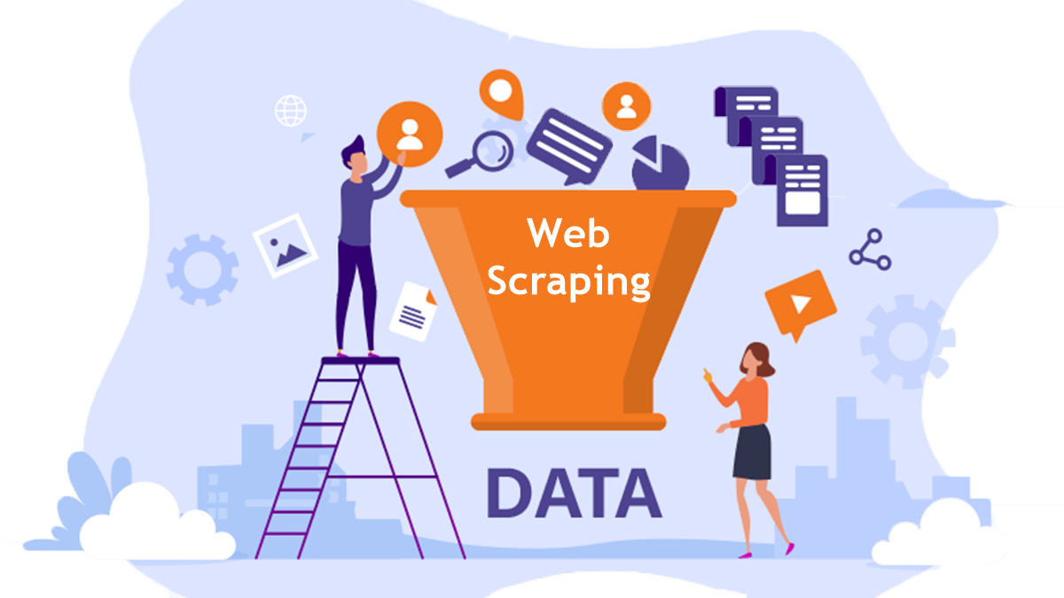
What is Web Scraping?
Definition
Web scraping is the process of using automated tools to extract large amounts of data from websites quickly and efficiently
Purpose
Collect and analyze data that is publicly available on the web
Examples
Price comparison, sentiment analysis, market research

Slide 4
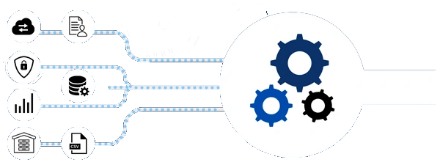
How Web Scraping Works
Access the Web Page
Send an HTTP request to the web server
Parse the HTML
Use HTML parsing libraries to navigate and search the HTML document
Extract Data
Identify the HTML elements containing the data and extract it
Store Data
Save the extracted data in a structured format such as CSV, JSON, or a database

Slide 5
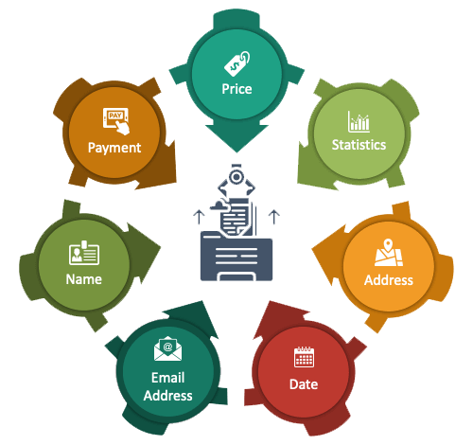
Uses of Web Scraping
Market Research
Collecting competitor prices, reviews, and product information
Data Analysis
Aggregating data for academic research, business insights, or trend analysis
Content Aggregation
Compiling news, blogs, or articles from various sources
Job Listings
Aggregating job postings from multiple job boards
Real Estate Listings
Gathering property listings from different real estate websites

Slide 6

Tools for Web Scraping
BeautifulSoup
A Python library for parsing HTML and XML documents. It provides Pythonic idioms for iterating, searching, and modifying the parse tree
Scrapy
An open-source Python framework for web scraping that handles requests, follows links, and extracts data
Selenium
A tool that automates web browsers, used for web scraping dynamic content rendered by JavaScript
Requests
A simple HTTP library for Python that allows you to send HTTP requests

Slide 7
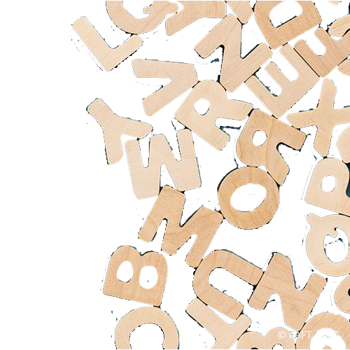
Basic Techniques
HTML Parsing
Using libraries like BeautifulSoup to navigate and search HTML documents
Example
Extracting titles and prices from an e-commerce site
DOM Manipulation
Using tools like Selenium to interact with and extract data from dynamically loaded content
Example
Scraping content that requires clicking a button or logging in
APIs
Accessing data through publicly available APIs that websites provide
Example
Using Twitter API to collect tweets for analysis

Slide 8
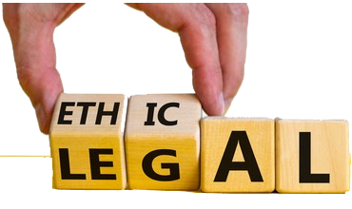
Legal and Ethical Considerations
Respect Robots.txt
Check the website’s robots.txt file to see which parts of the site are allowed to be scraped
Terms of Service
Review the website’s terms of service to ensure compliance
Rate Limiting
Implement rate limiting to avoid overloading the server with too many requests
Data Privacy
Be mindful of data privacy laws and avoid scraping personal data

Slide 9
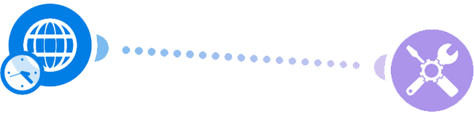




HTML Parsing using BeautifulSoup
Using BeautifulSoup (Python) to extract titles from a webpage
Install the necessary libraries
Example Code

Slide 10

What is the primary use of Matplotlib in Python?
BeautifulSoup
What function is used to send a request to a web page in the provided HTML parsing example?
requests.get

Slide 11

Practice beautifulSoup steps for Web Scrapping

